Slide 1


Smart Classroom Assistant
Computer Vision Course — CSE383
Automating Attendance, Mood Analysis & Question Classification using AI
Youssef Mohamed - 22100512 Omar Osama - 22101414
Ahmed Yasser - 22100397 Mariam Mahmoud - 22100808
ALAMEIN INTERNATIONAL UNIVERSITY
ALAMEIN UNIVERSITY
CSE383

Slide 2



What is the Smart Classroom Assistant?
The Smart Classroom Assistant is an AI-powered educational tool designed to streamline classroom management. By integrating Computer Vision, Speech Recognition, and NLP, the system automates routine tasks, allowing instructors to focus on teaching. It detects student presence, monitors engagement levels, and captures academic inquiries in real-time.
Computer Vision
Speech Recognition
NLP Analysis
Outputs generated as structured CSV logs for administrative review.
CSE383 - Final Project
Slide 02

Slide 3







Integration Workflow
Audio Captured
Camera Activates
Attendance Marked
Mood Logged
Text Transcription
Topic Predicted
Saved to CSV Log
An end-to-end automated pipeline connecting hardware sensors to structured data storage.
CSE383 - Final Project
Slide 03

Slide 4
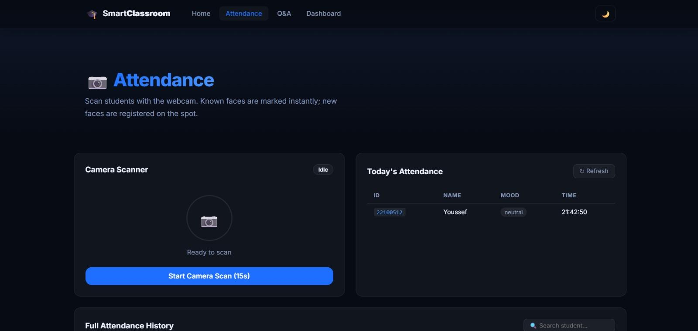
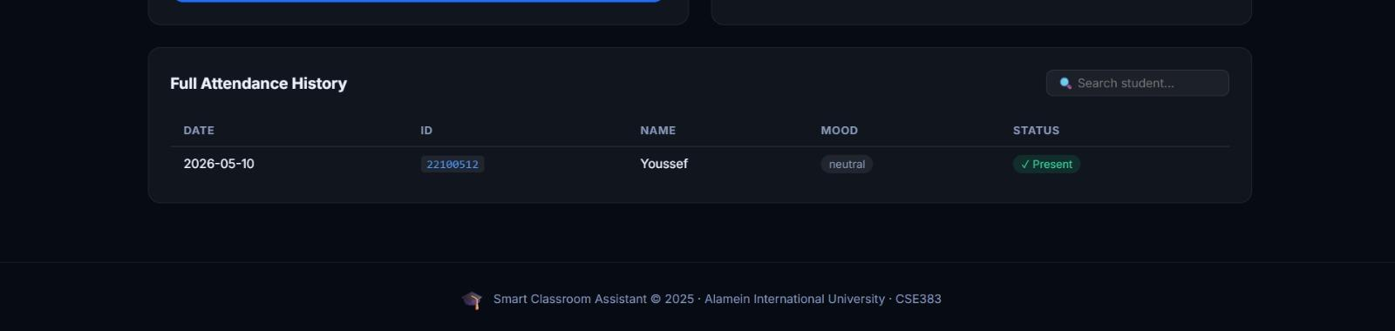
Face Recognition & Attendance
Built with OpenCV + face_recognition library
Loads known encodings from local 'faces' directory
Real-time comparison of live webcam frames
Automated attendance logging for known students
Flags unknown faces for manual intervention
CSE383 - Final Project
Slide 04

Slide 5
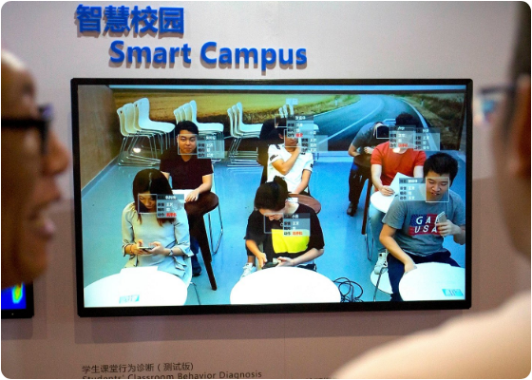
Student Mood Analysis
Powered by FER (Facial Expression Recognition)
Deep Learning (CNN) pre-trained model
Detects: Happy, Sad, Neutral, Angry, Surprised
Helps instructors measure lecture engagement
CSE383 - Final Project
Slide 05

Slide 6
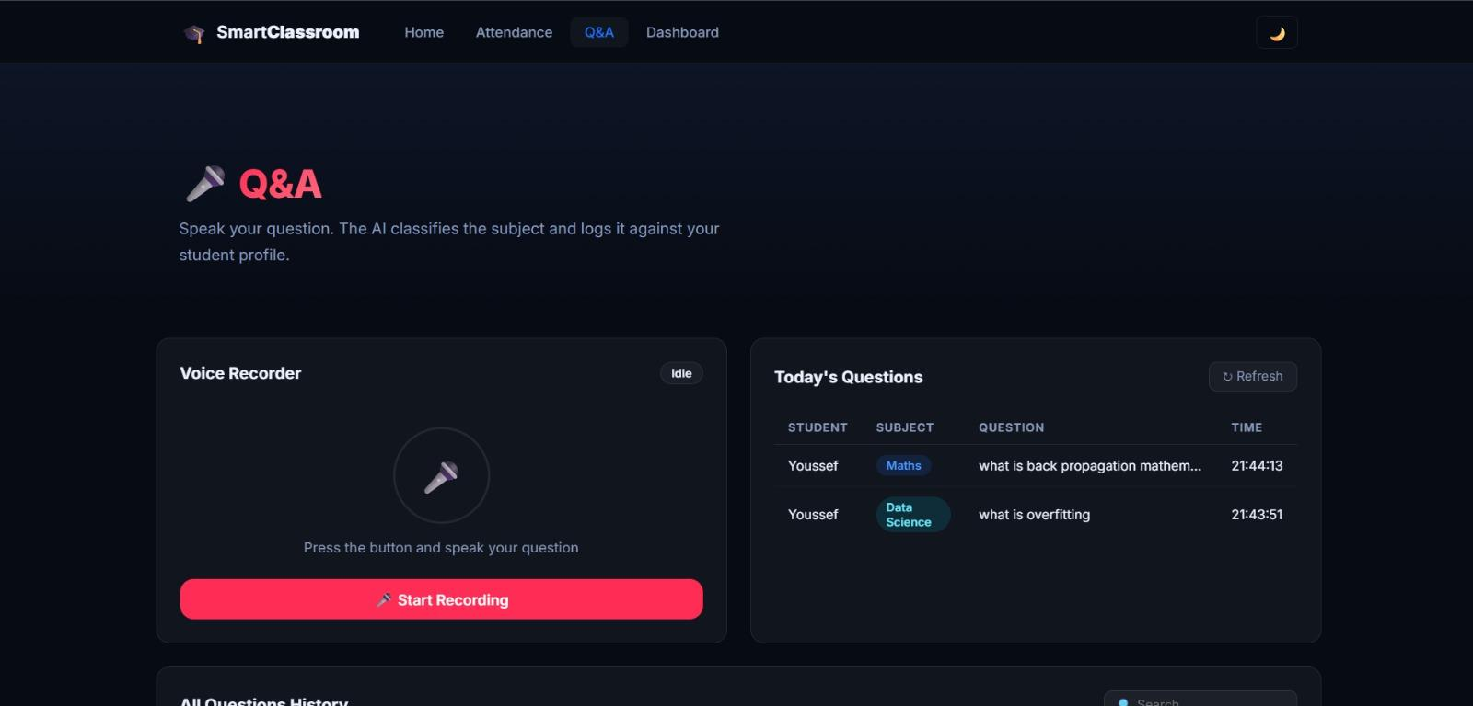

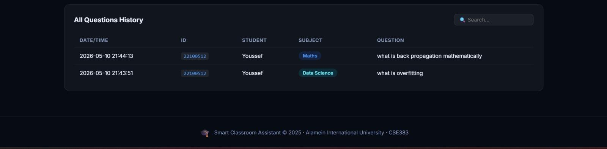
Capturing Student Questions
Utilizes Google Speech-to-Text API
Real-time audio capture via microphone
Intelligent silence and noise detection
Seamless transcription of complex queries
🎙️ Input: "Can you explain convolution?"
📝 Output: "Can you explain convolution?"
CSE383 - Final Project
Slide 06

Slide 7






Question Classification
Topic Categories:
Processing Pipeline:
1.
Vectorization via TF-IDF
2.
Naive Bayes / Logistic Regression Classifier
"What is gradient descent?" → Data Science
3.
Keyword-rich dataset training
4.
Multiclass label prediction
"Explain convolution" → Computer Vision
CSE383 - Final Project
Slide 07

Slide 8
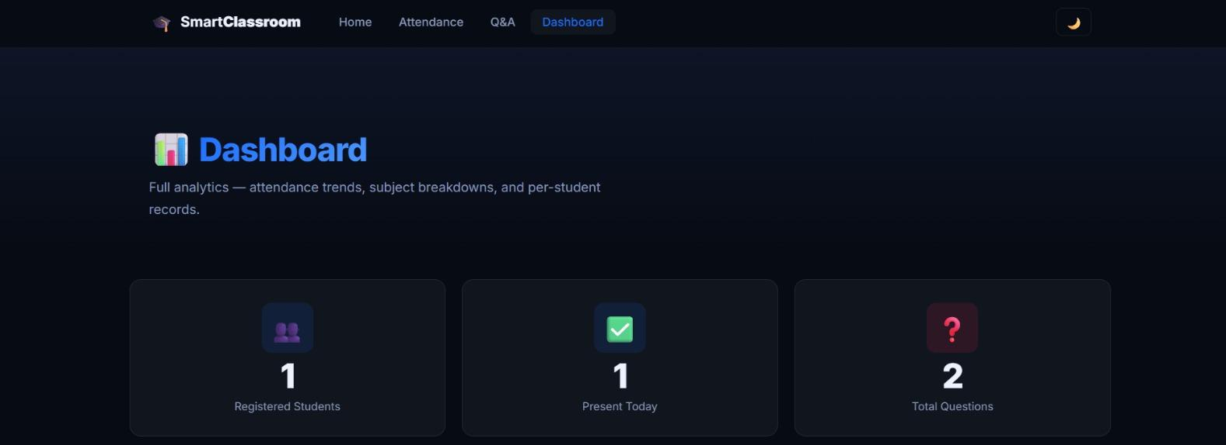
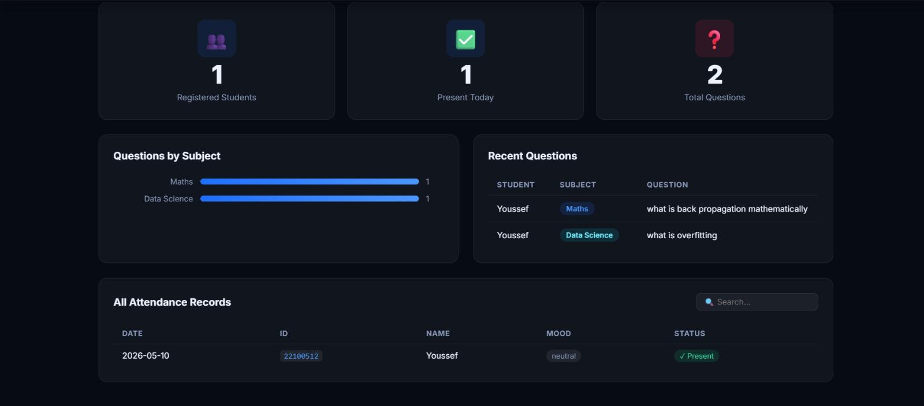
Flask Dashboard
Built with Python Flask Framework
Multi-page: Home, Dashboard, Attendance, Q&A
Python Threading for async recording
REST API endpoints for frontend data
CSE383 - Final Project
Slide 08

Slide 9
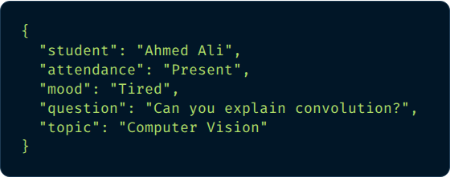


Structured Logs
Persistent Storage
The system maintains two primary CSV files for historical records and live dashboard updates:
attendance_log.csv
ID, Name, Date, Time, Mood
questions_log.csv
Timestamp, Student, Question, Subject
CSE383 - Final Project
Slide 09

Slide 10




Conclusion & Tech Stack
"The Smart Classroom Assistant successfully integrates Computer Vision, Speech Recognition, and NLP into one unified web-based system, demonstrating real-world AI application in education."
CV Module
Speech
OpenCV, face_recognition, fer (CNN)
SpeechRecognition, Google API
NLP
Web
Scikit-learn, TF-IDF, Naive Bayes
Flask, Threading, CSV Storage
Thank You!
ALAMEIN UNIVERSITY - CSE383
2025–2026

Slide 11

Image Sources
https://cdn.analyticsvidhya.com/wp-content/uploads/2018/06/ap18138266807030.jpg
Source: www.analyticsvidhya.com

